Slide 1

Computational Structures in Data Science
Lecture 7: Lambda & Abstract Data Types
UC Berkeley EECS Adj. Ass. Prof. Dr. Gerald Friedland
March 4, 2019
http://inst.eecs.berkeley.edu/~cs88

Slide 2

Computational Concepts Toolbox
Data type: values, literals, operations,
e.g., int, float, string
Expressions, Call expression
Variables
Assignment Statement
Sequences: tuple, list
indexing
Data structures
Tuple assignment
Call Expressions
Function Definition Statement
Conditional Statement
Iteration:
data-driven (list comprehension)
control-driven (for statement)
while statement
Higher Order Functions
Functions as Values
Functions with functions as argument
Assignment of function values
Recursion
Lambda - function valued expressions
Notes:
z = 1,2
x,y = 3,4
a,b = z

Slide 3


Universality
Everything that can be computed, can be computed with what you know now.
Poorly or Well

Slide 4
Evolution of Programming Languages

Slide 5
Today’s Lecture
Lambda
New Concept: Abstract Data Type
Example Illustration: key-value store
Internal representation 1: list of pair
Internal representation 2: pair of lists (including zip intro)
A simple application over the KV interface
New language construct: dict
Key-Value store 3: dict
Optional Exercises
http://bit.ly/cs88-fa18-L07
http://datahub.berkeley.edu/user-redirect/interact?account=data-8&repo=cs-connector&branch=gh-pages&path=ADT

Slide 6
lambda
Function expression
“anonymous” function creation
Expression, not a statement, no return or any other statement
lambda <arg or arg_tuple> : <expression using args>
inc = lambda v : v + 1
def inc(v):
return v + 1

Slide 7
Lambda Examples
>>> sort([1,2,3,4,5], lambda x: x)
[1, 2, 3, 4, 5]
>>> sort([1,2,3,4,5], lambda x: -x)
[5, 4, 3, 2, 1]
>>> sort([(2, "hi"), (1, "how"), (5, "goes"), (7, "I")],
lambda x:x[0])
[(1, 'how'), (2, 'hi'), (5, 'goes'), (7, 'I')]
>>> sort([(2, "hi"), (1, "how"), (5, "goes"), (7, "I")],
lambda x:x[1])
[(7, 'I'), (5, 'goes'), (2, 'hi'), (1, 'how')]
>>> sort([(2,"hi"),(1,"how"),(5,"goes"),(7,"I")],
lambda x: len(x[1]))
[(7, 'I'), (2, 'hi'), (1, 'how'), (5, 'goes')]
http://cs88-website.github.io/assets/slides/adt/mersort.py

Slide 8
Lambdas
>>> def inc_maker(i):
... return lambda x:x+i
...
>>> inc_maker(3)
<function inc_maker.<locals>.<lambda> at 0x10073c510>
>>> inc_maker(3)(4)
7
>>> map(lambda x:x*x, [1,2,3,4])
<map object at 0x1020950b8>
>>> list(map(lambda x:x*x, [1,2,3,4]))
[1, 4, 9, 16]
>>>

Slide 9
Abstract Data Type
Operations
Object
Constructors
A new Data Type
Selectors
Internal Representation
Operations
Implementation on that
Internal representation
External Representation
interface

Slide 10
Examples Data Types You have seen
Lists
Constructors:
list( … )
[ <exps>,… ]
[<exp> for <var> in <list> [ if <exp> ] ]
Selectors: <list> [ <index or slice> ]
Operations: in, not in, +, *, len, min, max
Mutable ones too (but not yet)
Tuples
Constructors:
tuple( … )
( <exps>,… )
Selectors: <tuple> [ <index or slice> ]
Operations: in, not in, +, *, len, min, max

Slide 11
More “Built-in” Examples
Lists
Tuples
Strings
Constructors:
str( … )
“<chars>”, ‘<chars>’
Selectors: <str> [ <index or slice> ]
Operations: in, not in, +, *, len, min, max
Range
Constructors:
range(<end>), range(<start>,<end>), range(<start>,<end>,<step>)
Selectors: <range> [ <index or slice> ]
Operations: in, not in, len, min, max

Slide 12
A New Abstract Data Type: Key-Value
Collection of key-Value bindings
Key : Value
Many real-world examples
Dictionary, Directory, Phone book, Course Schedule, Facebook Friends, Movie listings, …
Given some Key, What is the value associated with it?

Slide 13
Key-Value ADT
Constructors
kv_empty: create an empty KV
kv_add: add a key:value binding to a KV
kv_create: create a KV from a list of key,value tuples
Selectors
kv_items: list of (key,value) tuple in KV
kv_keys: list of keys in KV
kv_values: list of values in KV
Operations
kv_len: number of bindings
kv_in: presence of a binding with a key
kv_display: external representation of KV

Slide 14
A little application
from kv_pairs import *
phone_book_data = [
("Christine Strauch", "510-842-9235"),
("Frances Catal Buloan", "932-567-3241"),
("Jack Chow", "617-547-0923"),
("Joy De Rosario", "310-912-6483"),
("Casey Casem", "415-432-9292"),
("Lydia Lu", "707-341-1254")]
phone_book = kv_create(phone_book_data)
print("Jack Chows's Number: ", kv_get(phone_book, "Jack Chow"))
print("Area codes")
area_codes = list(map(lambda x:x[0:3], kv_values(phone_book)))
print(area_codes)

Slide 15
A Layered Design Process
Build the application based entirely on the ADT interface
Operations, Constructors and Selectors
Build the operations in ADT on Constructors and Selectors
Not the implementation representation
Build the constructors and selectors on some concrete representation

Slide 16
Example 1
KV represented as list of (key, value) pairs

Slide 17
Example 2
KV represented as pair of lists – (keys, values)

Slide 18
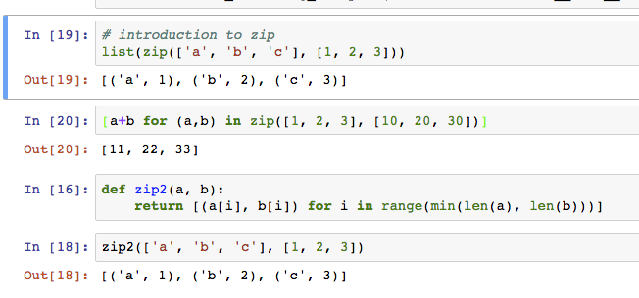
zip
Zip (like a zipper) together k lists to form a list of k-tuples

Slide 19
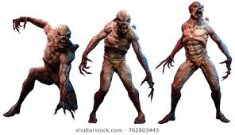
Dictionaries
Lists, Tuples, Strings, Range
Dictionaries
Constructors:
dict( <list of 2-tuples> )
dict( <key>=<val>, ...) # like kwargs
{ <key exp>:<val exp>, … }
{ <key>:<val> for <iteration expression> }
>>> {x:y for x,y in zip(["a","b"],[1,2])}
{'a': 1, 'b': 2}
Selectors: <dict> [ <key> ]
<dict>.keys(), .items(), .values()
<dict>.get(key [, default] )
Operations:
Key in, not in, len, min, max
<dict>[ <key> ] = <val>

Slide 20
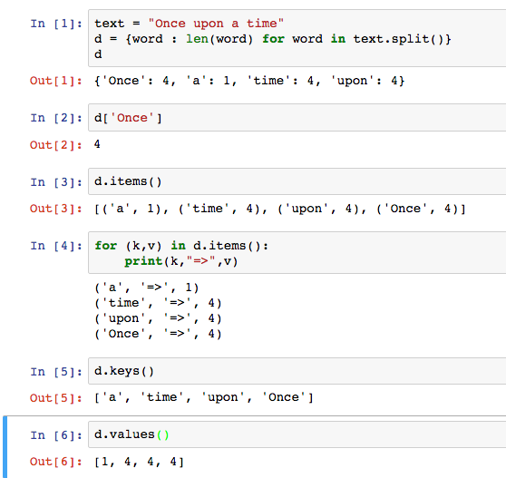
Dictionary Example

Slide 21
Beware
Built-in data type dict relies on mutation
Clobbers the object, rather than “functional” – creating a new one
Throws an errors of key is not present
We will learn about mutation shortly

Slide 22
Example 3
KV represented as dict

Slide 23
Building Apps over KV ADT
friend_data = [
("Christine Strauch", "Jack Chow"),
("Christine Strauch", "Lydia Lu"),
("Jack Chow", "Christine Strauch"),
("Casey Casem", "Christine Strauch"),
("Casey Casem", "Jack Chow"),
("Casey Casem", "Frances Catal Buloan"),
("Casey Casem", "Joy De Rosario"),
("Casey Casem", "Casey Casem"),
("Frances Catal Buloan", "Jack Chow"),
("Jack Chow", "Frances Catal Buloan"),
("Joy De Rosario", "Lydia Lu"),
("Joy De Lydia", "Jack Chow")
]
Construct a table of the friend list for each person

Slide 24
Example: make_friends
def make_friends(friendships):
friends = kv_empty()
for (der, dee) in friendships:
if not kv_in(friends, der):
friends = kv_add(friends, der, [dee])
else:
der_friends = kv_get(friends, der)
friends = kv_add(kv_delete(friends, der),
der, [dee] + der_friends)
return friends

Slide 25
C.O.R.E concepts
Perform useful computations treating objects abstractly as whole values and operating on them.
Compute
Operations
Provide operations on the abstract components that allow ease of use – independent of concrete representation.
Abstract Data Type
Representation
Constructors and selectors that provide an abstract interface to a concrete representation
Evaluation
Execution on a computing machine
Abstraction Barrier

Slide 26
Creating an Abtract Data Type
Constructors & Selectors
Operations
Express the behavior of objects, invariants, etc
Implemented (abstractly) in terms of Constructors and Selectors for the object
Representation
Implement the structure of the object
An abstraction barrier violation occurs when a part of the program that can use the higher level functions uses lower level ones instead
At either layer of abstraction
Abstraction barriers make programs easier to get right, maintain, and modify
Few changes when representation changes

Slide 27
Exercises
Read 2.2, reread 2.3, esp 2.3.6
Modify all three KV ADTs to avoid ever adding duplicate keys
Create and ADT for a shopping cart containing a collection of products and their order count
cart() – creates an empty cart
cart_add(ct, product) – returns a new cart that includes an additional order of product, or the first one
cart_print(ct) – prints the contents of the cart
cart_products(ct) – returns the list of products ordered
cart_items(ct) – returns list of (product, count)
cart_remove(ct, product) - returns a new cart with product removed
Create an 1D array abstraction (like np.array) using lists as representation

Slide 28
Thoughts for the Wandering Mind
Consider the following simple Python code:
x = input("Enter a number between 0 and 1:")
for i in range(10):
x=-x**2+4*x
print x
Plot the function implemented by the code.
Could you predict using sampling (e.g., interpolate from the results of inputs 0, 0.25, 0.5, 0.75, 1)?
Could you predict using calculus (e.g., using the derivative of f(x)=-x²+4x)?
Could a neural network learn the function, given enough (input, output) tuples as training data?

